Slide 1
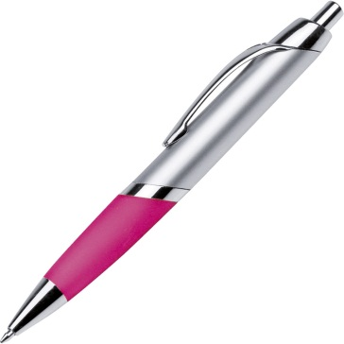
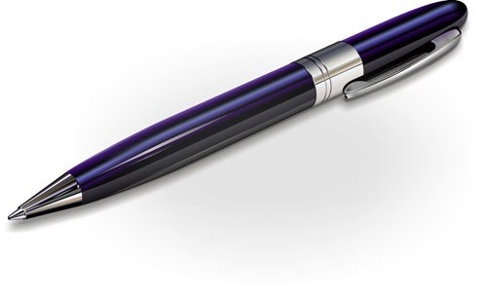
That is a pink pen.
This is a blue pen.

Slide 2
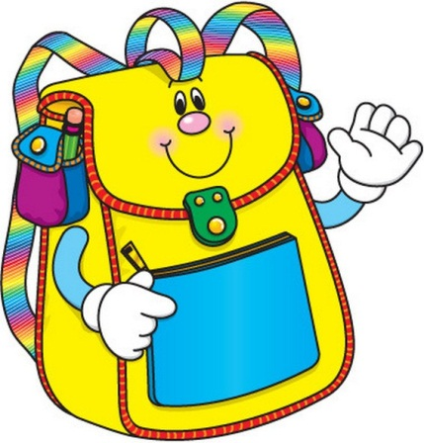

That is a yellow bag.
This is a blue bag.

Slide 3
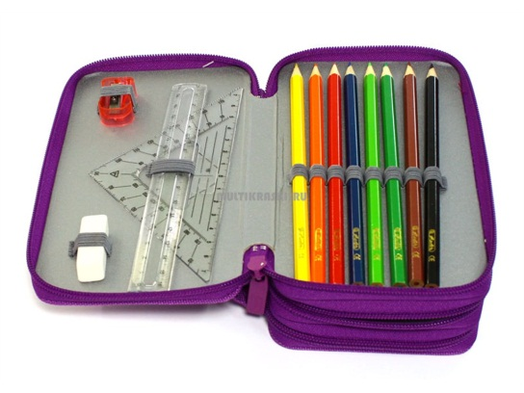
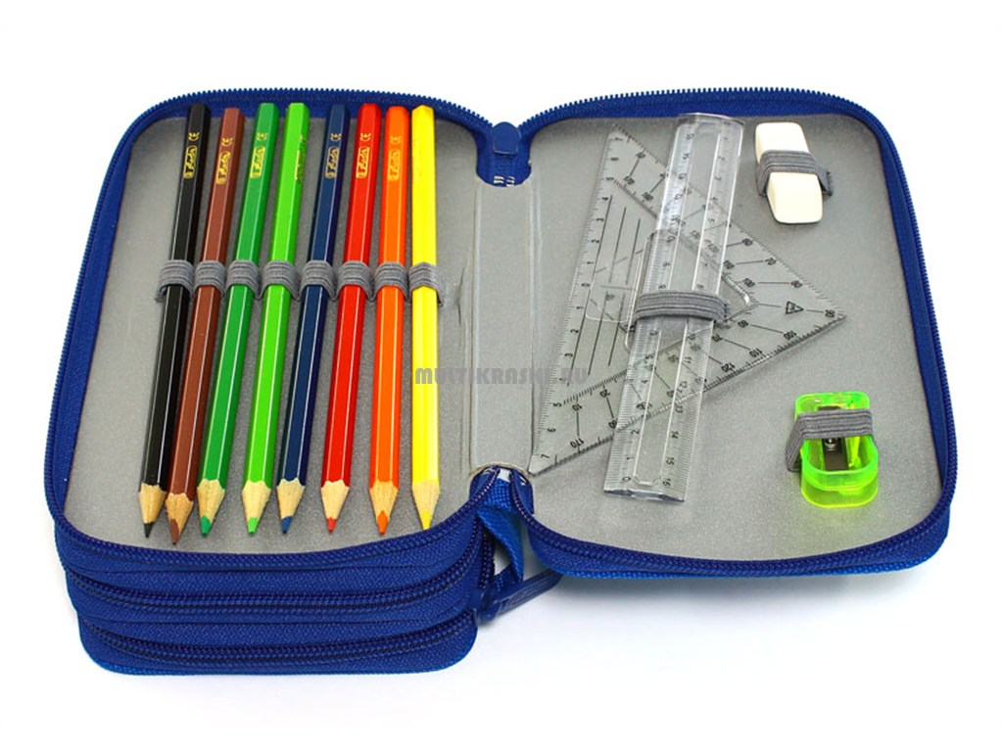
That is a ....
This is a ….

Slide 4


That is a ....
This is a ….

Slide 5
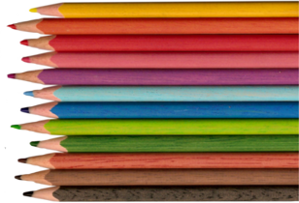
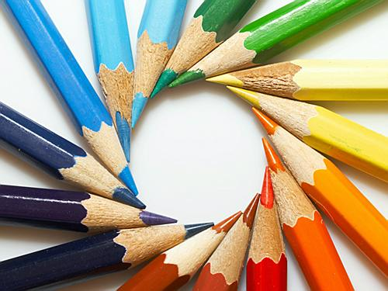
Those are pencils.
These are pencils.

Slide 6
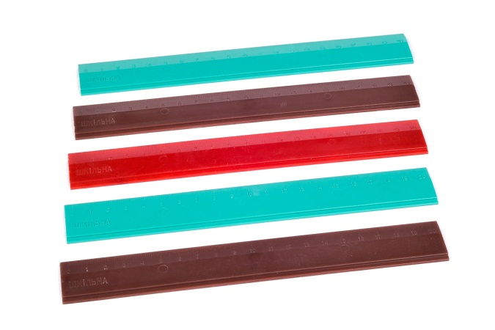
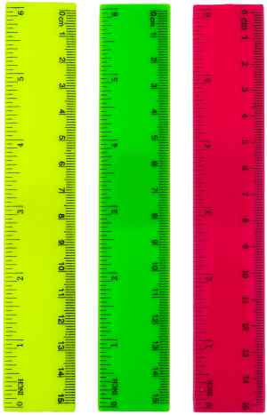
Those are rulers.
These are rulers.

Slide 7
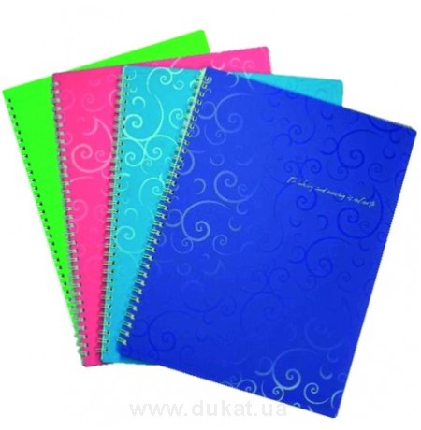
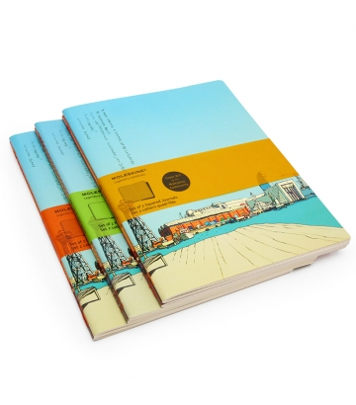
Those are copybooks.
These are copybooks.

Slide 8
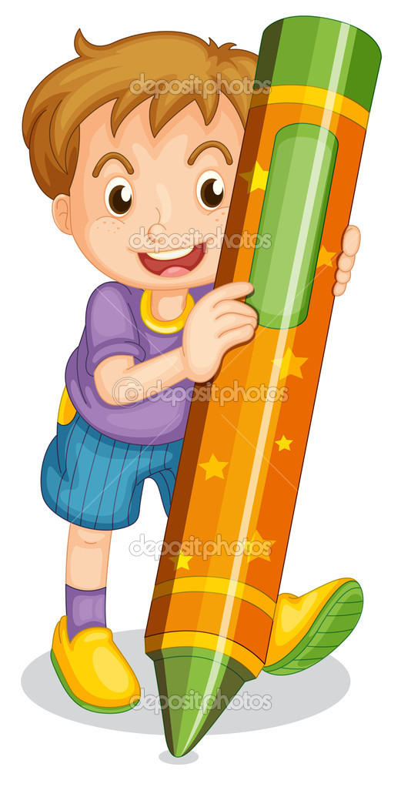
It is Bill’s pencil.

Slide 9

It is Pam’s book.

